Slide 1
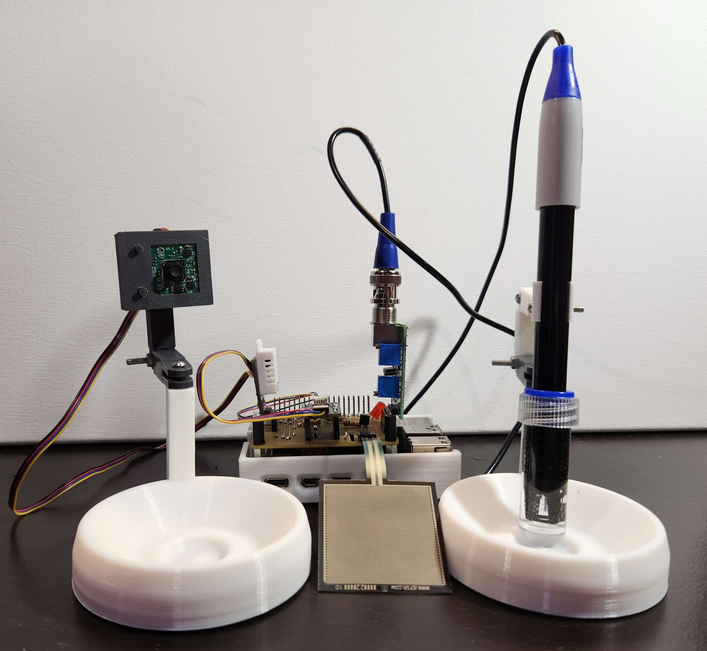
Pet Monitor
Aaron Morris Basco Jara
SEN-21231 (Presence Sensor)
Jasnam Singh Gill
DHT22 (Temperature Sensor)
Robert Rowlison
PH-4502C (PH Sensor)
Damanpreet Singh
Resistive 3us Analog sensor

Slide 2
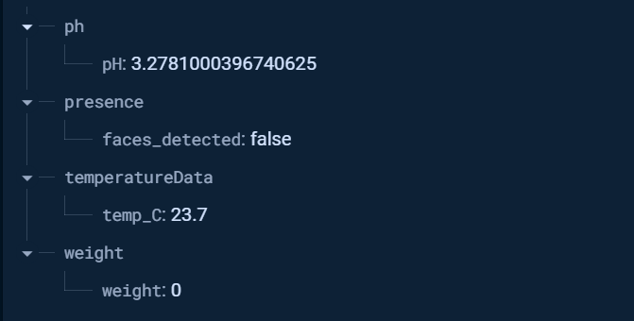
Database

Slide 3
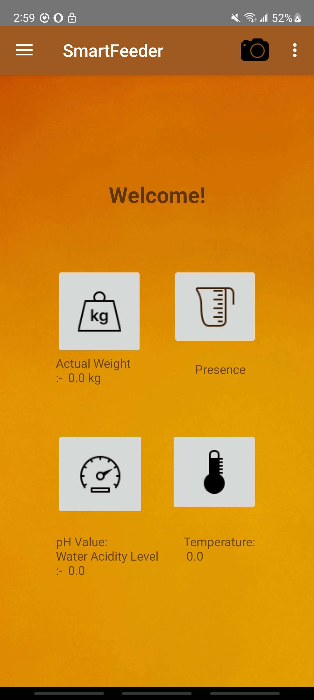
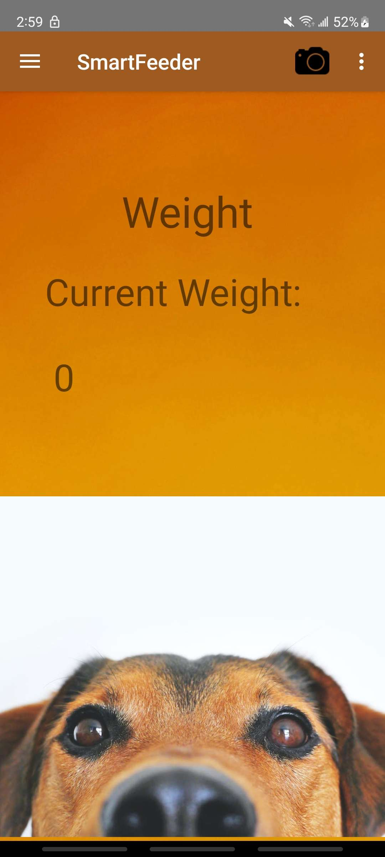
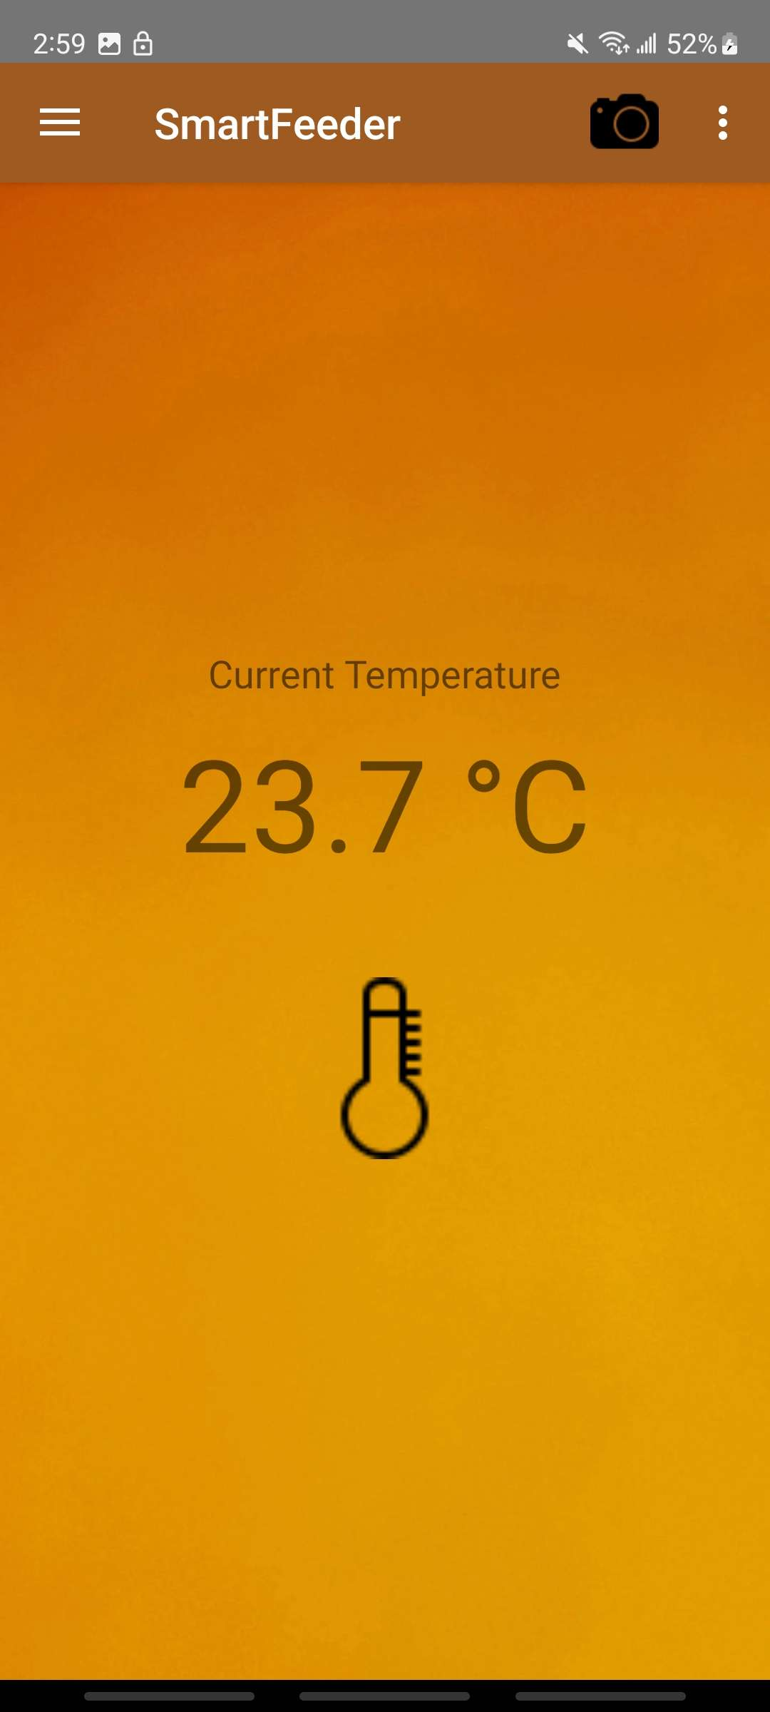
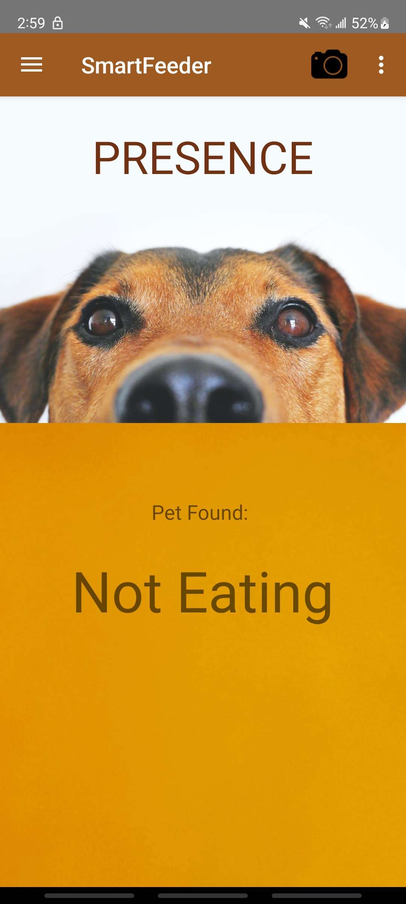
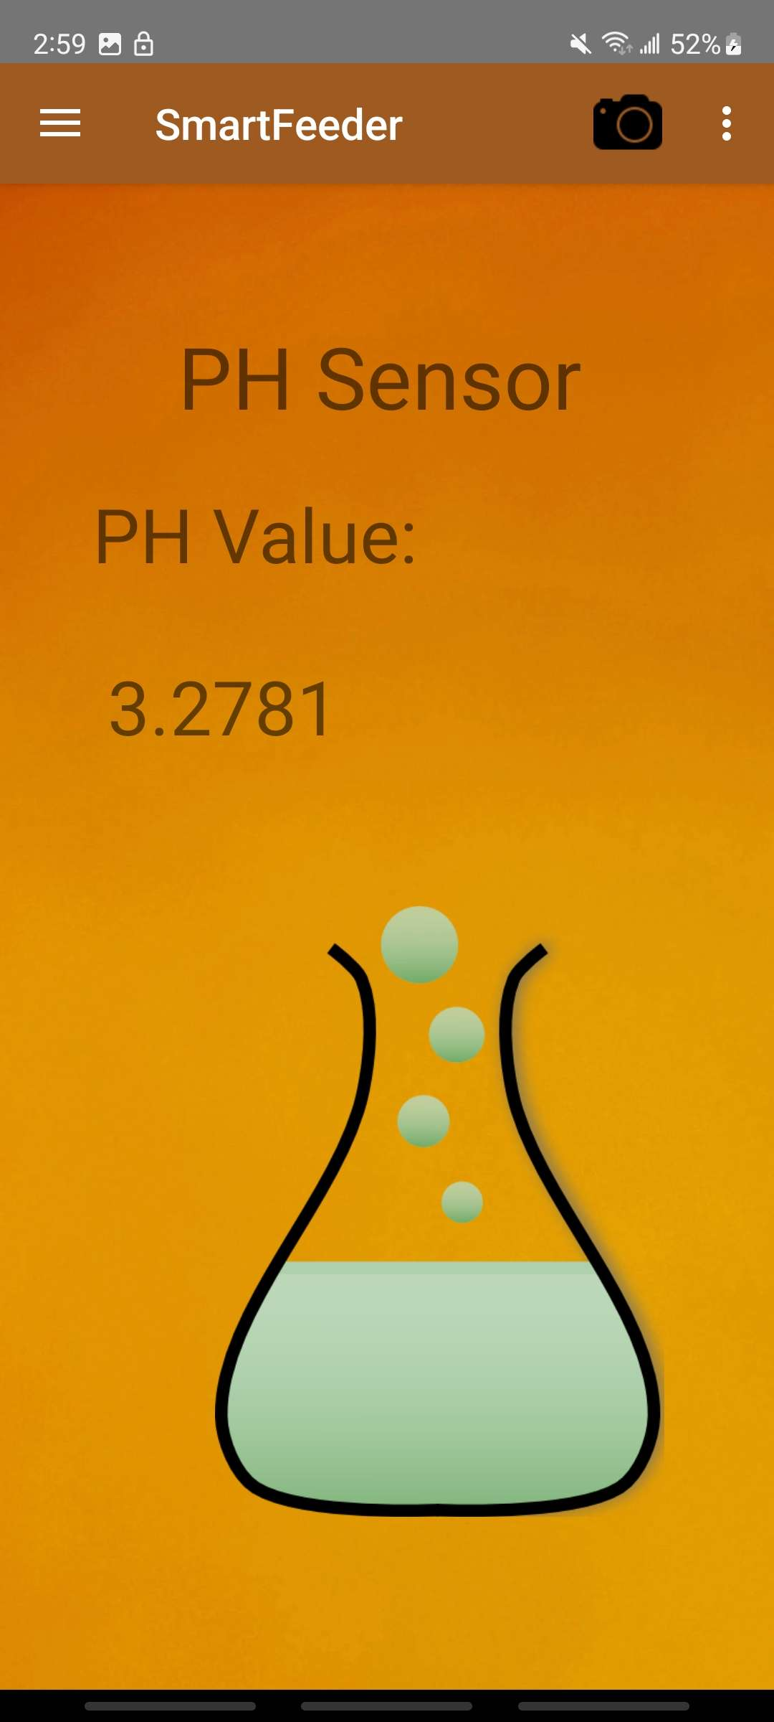
App
Home Page
Weight Page
Temperature Page
Presence Page
PH Page

Slide 4

Setup
Open the app
Connect pi to hotspot
Make sure all sensors are connected

Slide 5
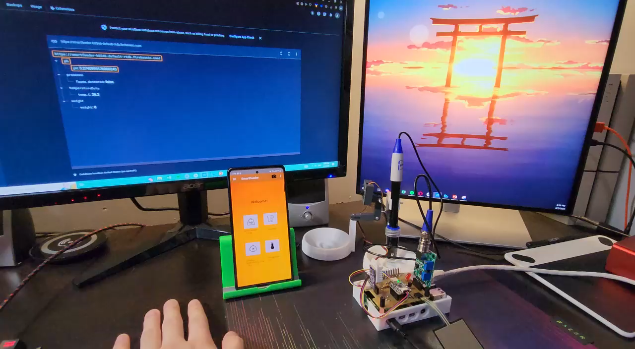
Demonstration
Demonstrate how depending on the amount of pressure applied to the weight sensor the value changes, changes in temperature, ph reading, and presence are reflected in the app.

